Slide 1
CAPSTONE PROJECT
Analysis of Customer Churn prediction
in Logistic Industry

Slide 2
GROUP 1
MEMBERS:
UTKARSH NIPANE
SIDDHARTH KHANNA
SHIVAM VERNEKAR
MANOJ KAUSHIK

Slide 3
INTRODUCTION
Customer churn prediction:
Refers to the methods of detecting customers who are likely to cancel a subscription or a service. Customer churn prediction in logistics industry is one of the most prominent research topics in recent years. The Logistics Market off late has got into a state of saturation due to fierce competition and therefore the focus has shifted to retaining customers as much as possible.
Churn rate:
Is a measure of the number of individuals or items moving out of a collective group over a specific period.

Slide 4
Problem Statement:
Using the data set, of a premier Shipping and Logistics company, use RFM to classify customers and do factor engineering and build a model that can predict churn.
Scope of the Project:
To perform Customer Churn analysis
About the dataset :
The dataset contains information about a premier shipping and logistics company.
Contains 600 records and 16 features with the target variable as “CustomerChurn”
Provides details of the customers including Invoice Amount, Average miles travelled, Volume Change, Competitors Present, Current Inflation, Claims made etc.

Slide 5
Agenda
Objective & About the Data.
Data processing and cleaning.
EDA and Inferences.
Model Building and Evaluation.
Business Advice for the problem.

Slide 6
Objective & About the Data.
Objectives of the project :
Build a Machine Learning model to predict Customer Churn from the data provided.
About the Data:
The given data set has 600 rows and 16 variables.
There are 3 continuous variables , 9 categorical variables and 3 discrete variables.
There are no missing values in the dataset.
There are a few outliers in the dataset.
There is heavy class imbalance in the Target Variable.

Slide 7
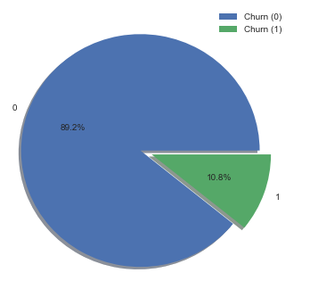
Class Imbalance

Slide 8
Data Processing and Cleaning.
Outliers in the data set have been imputed with the 95th quantile value for continuous variables.
The skewness in the distributions have been brought to approximate normal by logarithmic transformation.
The variable ‘LocationName’ has been used to extract the names of the City and States and Regions.
The variable ‘LastInvoiceDate’ has been used extract information such as recency and frequency.

Slide 9

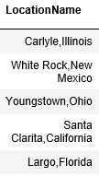

FEATURE ENGINEERING: LocationName

Slide 10
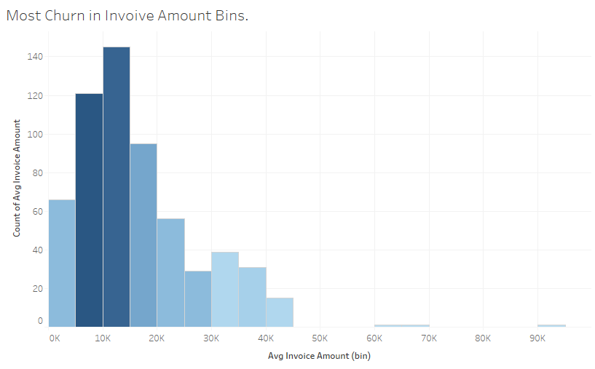
EDA and Inferences.
1
Factors contributing for churn are present in the invoice amount Range of 5K to 15K.
Most Churn is seen in this range. 70% churn is seen in this range

Slide 11
Findings in the Invoice Amount range of 5K to 15K.
Variable Name | Percentage of variables in Avg Invoice Amount 5K to 15K (bins) | Actual Number In given bin percentage | Total Number
Customer Churn | 70% | 45 Customers | 65 Customers
Percentage of competitors are present | 75% | 15 competitors | 20 competitors
Percentage number of calls made | 58% | 97 calls | 169 calls
Percentage of Claims | 80% | 27 claims | 34 claims
Pickup Delays | 76% | 28 Pickup Delays | 37 Pickup Delays

Slide 12
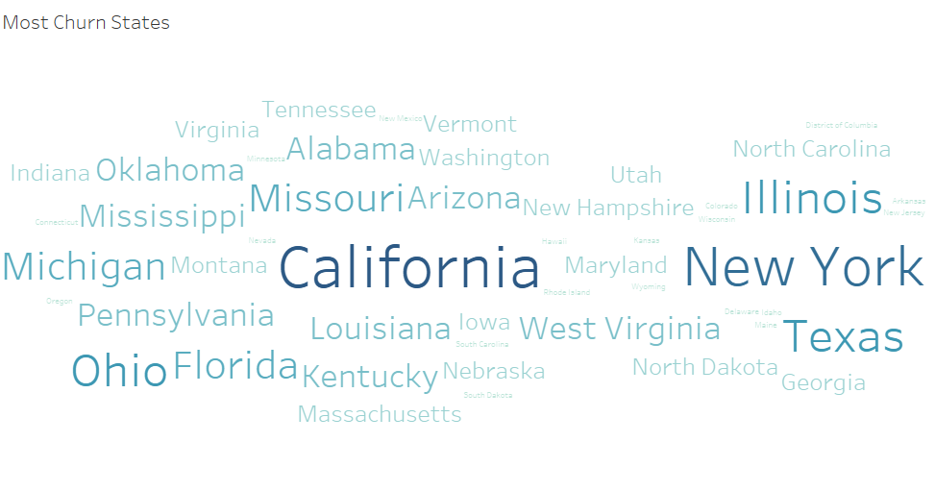
Competitors Present , Current inflation , No of Calls made, Claims made, Pickup Delay, etc. i.e. poor customer service has a major impact on the customers trust in the company and all of these reasons are seen for the customers which have churned.
California, New York, Ohio, Texas, Illinois have large number of customer churning.

Slide 13
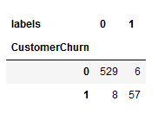
SEGMENTATION USING UNSUPERVISED LEARNING:
K-Means clustering to segment the data into two clusters with labels 0 and 1. Cluster Label 0 has 537 data points and Cluster label 1 has 63.
The cluster labelled as 1 has customers which have a high number of customer churn. The features seen in this cluster reflect poor customer service. This is the reason for churn. Also this cluster contains 90% churn.
Thus, K-Means clustering is properly able to segment the data into two categories. The customers who will churn and the customers wo won’t churn.

Slide 14
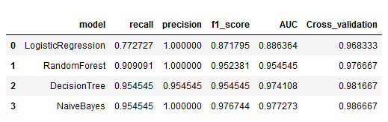
We realized for a dataset with heavy class imbalance Recall and Precision metrics are better judges of the model. We applied the models given below in the stipulated time. Naive Bayes provided best results.
Model Building and comparison.

Slide 15
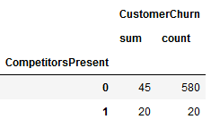
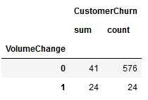
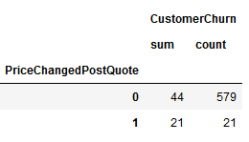
Why Naïve Bayes over other algorithms?
The Naive Bayes algorithm is based on conditional probabilities. It uses Bayes' Theorem, a formula that calculates a probability by counting the frequency of values and combinations of values in the historical data. Super simple, you’re just doing a bunch of counts.
If the NB conditional independence assumption actually holds, a Naïve Bayes classifier will converge quicker than discriminative models like logistic regression, so you need less training data.

Slide 16


Why Naïve Bayes over other algorithms?
High Cross Validation Accuracy score.
High Recall and Precision value.
Model did not over-fit or under-fit.
Assumption of independence of features holds true.
High Performance of Naïve Bayes model and performs pretty well.
Our data set was small and Naïve Bayes performs well with categorical features.
For Test Data
For Train Data

Slide 17
Business Advice for the problem.
The churn can be predicted by identifying the type of customers and improving customer service in particular for the customers which are likely to churn.
Also, rolling out offers that provide a cheaper tariff with high reliability so that customers are happy and content with the price they are paying for the service and do not go to any other service provider.

Slide 18
Thank you!

